Slide 1
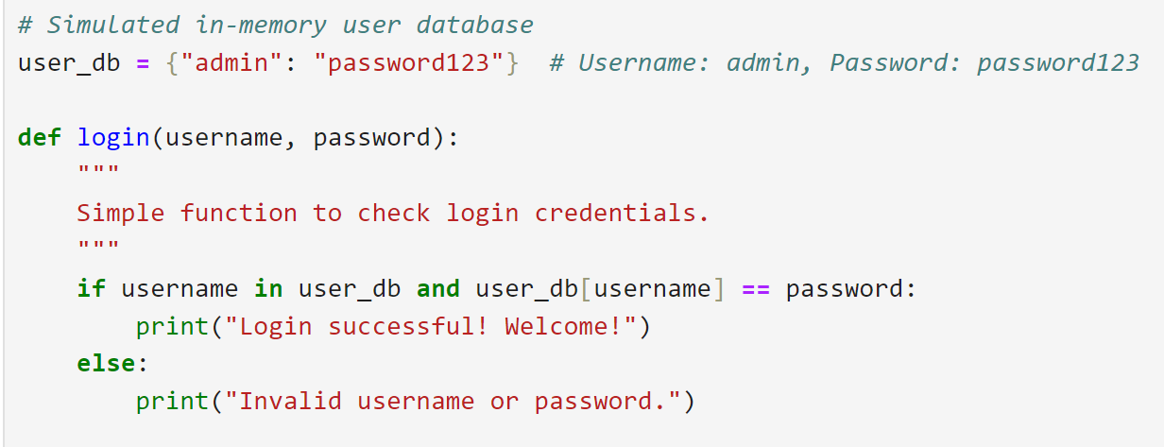

Slide 2
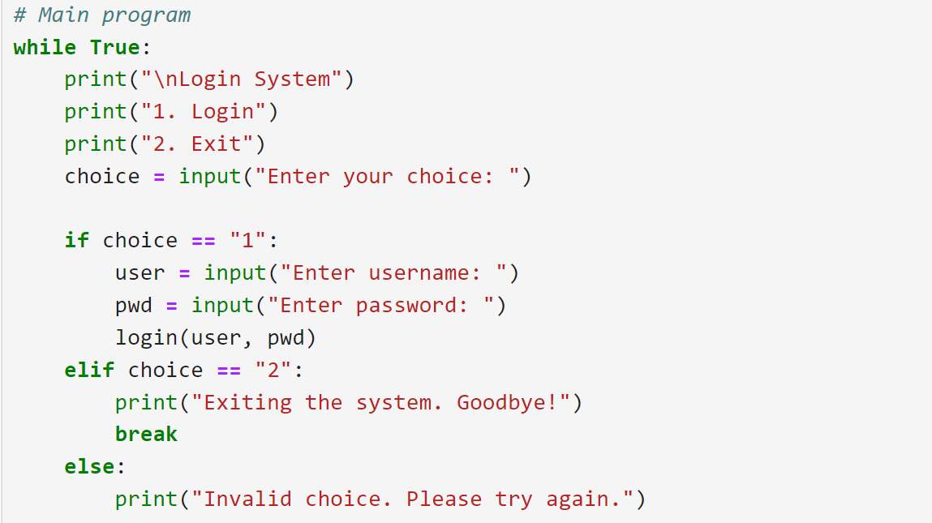

Slide 3
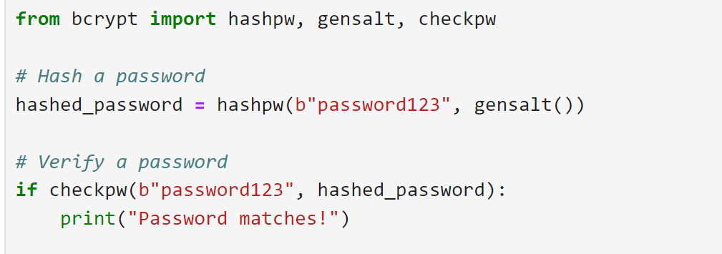
Storing Passwords Securely
Hash Passwords: Store hashed versions of passwords using a strong hashing algorithm like bcrypt, argon2, or PBKDF2.

Slide 4
3. Implementing Login Attempt Limits to Prevent Brute Force Attacks
Track Failed Attempts: Store the number of failed login attempts in the database or in-memory cache (e.g., Redis).
Lock Accounts Temporarily: After a threshold of failed attempts (e.g., 5), lock the account for a duration (e.g., 15 minutes).
Implement IP Blocking: Block requests from suspicious IP addresses after a certain number of failed attempts.

Slide 5
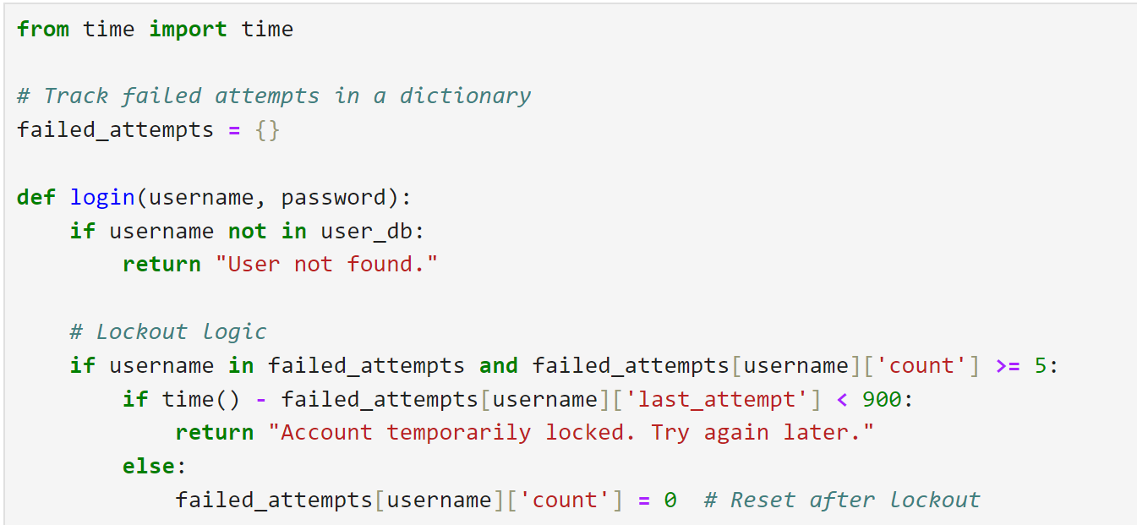
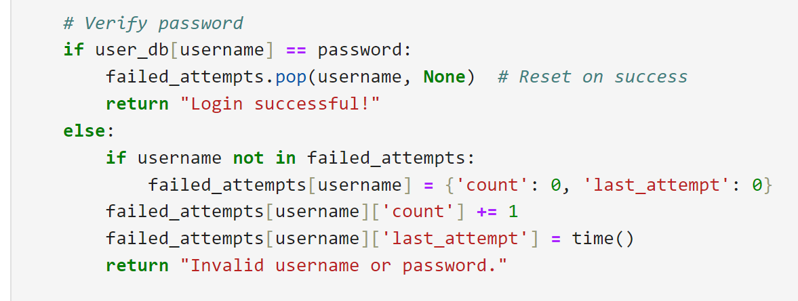

Slide 6
Use CAPTCHAs (Completely Automated Public Turing test to tell Computers and Humans Apart): Add CAPTCHAs after repeated failed login attempts to prevent automated attacks.

Slide 7
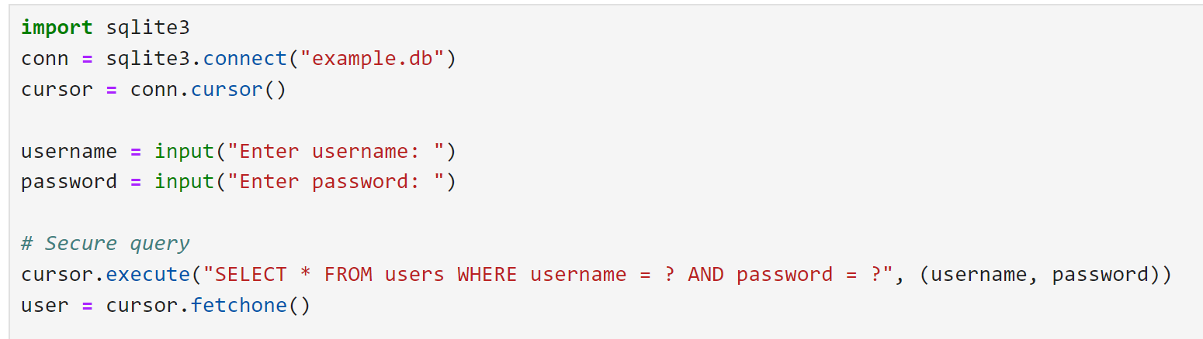
4. Handling User Input to Prevent Vulnerabilities
Sanitize Input: Use input validation to ensure only acceptable data is processed. For example, validate usernames and passwords for length and allowed characters.
Avoid SQL Injection: Use parameterized queries or ORM (Object-Relational Mapping) tools like SQLAlchemy for database interactions.

